Slide 1
Climate change and the role of the Red Cross and Red Crescent
Photo: Netherlands Red Cross
Notes:
The previous module introduced the scientific facts about climate change and some of its impacts. This module will explain the commitments of the Red Cross and Red Crescent to this agenda, and explains how it touches upon our work as laid out in the
IFRC Framework for Climate Action towards 2020
Movement Ambition for addressing the climate crisis

Slide 2
Session summary
1. Urgency to address climate change as part of our work
2. Movement ambitions on climate
3. Who does what?
4. How can we get started?
Photo: Alex Wynter/IFRC

Slide 3
200 million people dependent of humanitarian assistance per year by 2050, compared by 108 million today
20 billion USD needed annually by 2030
We still have a chance to act!
Notes:
The Cost of Doing Nothing – published by the IFRC & World Bank and launched at the Climate Action Summit in New York September 2019.
The report_
- shows the clear and frightening cost of doing nothing. But it also shows there is a chance to do something
- estimates that the number of people in need of humanitarian assistance in 2050 as a result of storms, droughts and floods could climb beyond 200 million annually compared to an estimated 108 million today = Doubling.
suggests that this rising human toll would come with a huge financial price tag, with climate-related humanitarian costs ballooning to US$ 20 billion per year by 2030 in the most pessimistic scenario.
shows that we are facing a stark choice: No action, and costs are likely to escalate.
These findings confirm the impact that climate change is having, and will continue to have, on some of the world’s most vulnerable people.
It also demonstrates the strain that increasing climate-related disasters could place on aid agencies and donors. By investing in climate adaptation and disaster risk reduction, including through efforts to improve early warning and anticipatory humanitarian action, the world can avoid a future marked by escalating suffering and ballooning humanitarian response costs.

Slide 4
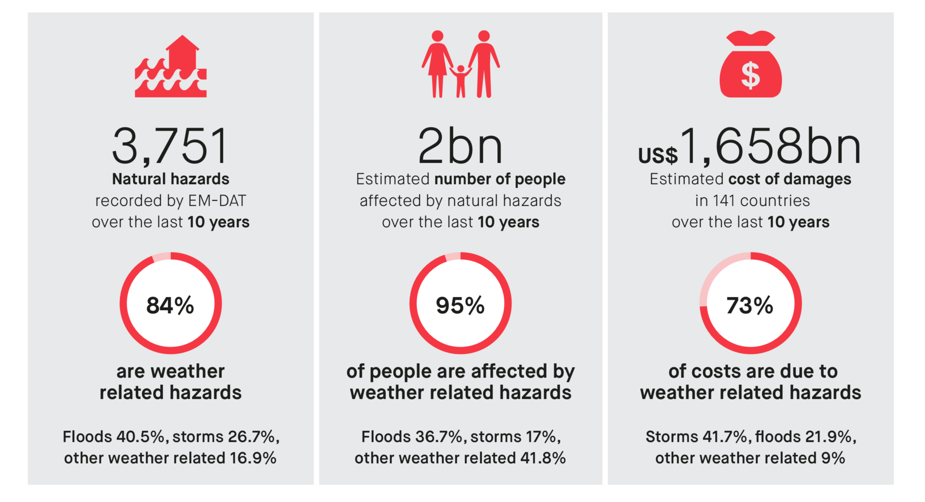
In 2018…
Source: World Disaster Report 2018
Notes:
Options for the facilitator: you can hide the % and ask the audience to guess what % should be in the red circle.
Climate change is often portrayed as a long-term gradual process – but for vulnerable people, and the Red Cross Red Crescent, however, a probably even bigger concern is the increase in extreme events.
For a few years now, we have been better in looking at extreme events, and researching if climate change has contributed to the intensity, magnitude or frequency of that particular event. We were able to put a number to a specific risk. This does not mean that scientists can show that every climate-related hazard has been made more frequent by climate change.
Three examples:
But the scorching heat in Europe 2018? Similar temperatures are now up to ten times more likely in some places.
Hurricane Harvey’s extreme rainfall in 2017, which resulted in nearly US$ 100 billion worth of damage in Houston, Texas? A repeat is three times more likely.
The 2018 water crisis in Cape Town? Its likelihood of recurring is tripled by climate change.
The increase in number and sometimes severity of small to medium scale disasters is already putting a higher demand on the disaster response system – the Red Cross Red Crescent has to assist an ever-increasing number of affected people – and there is an increasing turnover in the IFRC Disaster Relief and Emergency Fund (DREF).
According to IFRC and the CRED database, it is weather-related disasters including floods, droughts and storms which affect the most number of people, and the increase in Red Cross Red Crescent response and type of operations supported by DREF are primarily to weather-related events.
During the last few decades, floods and storms have been the primary type of disaster caused by natural hazards around the world – though even more people were affected by droughts and extreme temperatures.

Slide 5
Changing patterns
Shifting (rainy) seasons
(New types of) extreme events and increased climate variability
Health challenges – heat and water related
Food security and water
Photo: Michael Tsegaye/IFRC
Notes:
5
With the increasing uncertainty in climate, we may continue to see changing patterns in the main disaster categories which humanitarian organisations need to address.
Firstly, “Patterns” does not only refer to changes in frequency or severity of the disasters, but also that they may hit in new areas (for example a cyclone/typhoon/hurricane making landfall in areas previously never experiencing it before, or vector-borne diseases spreading to new areas).
Secondly, it might also mean that seasons are shifting, without clear ‘traditional’ warning signs, which means uncertainty for for instance farmers.
Or new challenges are also rising – such as for instance sea level rise – with impacts in coastal areas, most extremely in the Pacific and Bangladesh, where large areas may end up being uninhabitable or salinated (salt water influx, for instance into ground water).

Slide 6
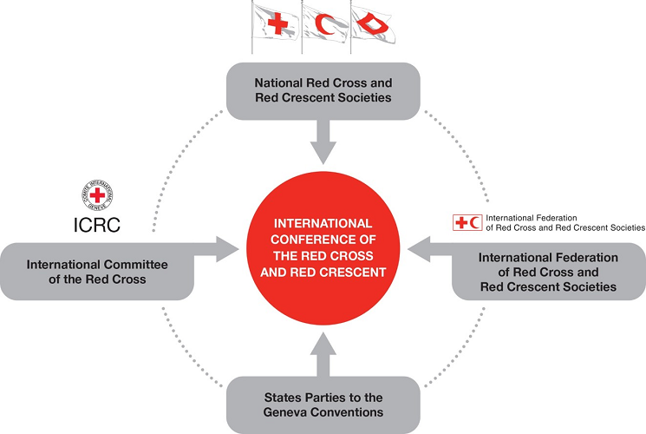
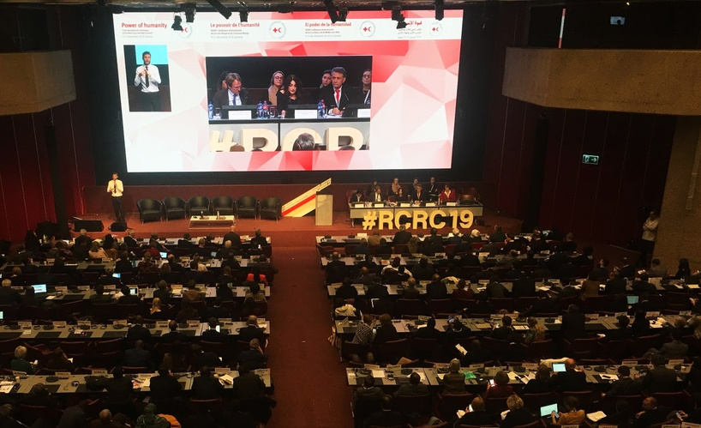
The Red Cross Red Crescent commitments
2007 International Conference Resolution ‘Together for Humanity’:
Commits to address climate change by:
raise awareness on climate change
provide humanitarian assistance
improve capacity to respond
decrease vulnerability of communities most strongly affected
integrate climate risk management into policies and plans
mobilise human and financial resources,
prioritize actions for the most vulnerable
2019 International Conference Resolution ‘Disaster laws and policies that leave no one behind’:
Encourages States to:
ensure an integrated approach to disaster risk management and adaptation to climate change
integrate innovative approaches to disaster risk management in their laws, policies, strategies and plans
guard against all forms of discrimination
Encourages National Societies to:
continue to support to their governments in the development and implementation of effective legal and policy frameworks relevant to disaster risk management and to climate change adaptation
International conference 2007
Notes:
6
6
Of course, any humanitarian organisation will have to consider how it will adapt to changes in the occurrence of disaster events and risk patterns and prepare for “more work and challenges.”
The Red Cross Movement has raised the issue at the highest level: The International Conference of the Red Cross and Red Crescent, which brings together the world’s largest humanitarian network and the world’s governments in a conference to debate major humanitarian challenges. It is attended by the International Committee of Red Cross (ICRC), the International Federation of Red Cross and Red Crescent Societies (IFRC) and all the National Red Cross and Red Crescent Societies (192 by 2019); on the government side, all 194 States that are party to the Geneva Conventions attend.
The International Conferences (IC) normally take place every 4th year
In 2007 climate change was one of the four main subjects of this conference – and resolution was passed (see below and slide),
in 2011 “Humanitarian consequences of climate change” was the theme for one of the 8 “workshops”
In 2019 was the topic of several side events and sessions, and a and new resolution was passed with reference to climate and changing risks (see below and slide)
In 2007, with the final Resolution and the commitment of the NSs, ICRC, IFRC and governments, climate change now needs to be implemented in the policy plans and programs of all National Societies. Commitments were made to address climate change in the following ways (see slide):
Source: See Resolution 1: https://www.icrc.org/eng/resources/documents/resolution/30-international-conference-resolution-1-2007.htm
In 2019 the International Conference, there was a focus on the humanitarian impacts of climate change, drawing attention to key challenges and opportunities, and identifying what can be done now to scale up joint action. Commitments to address changing risks were reiterated, partly through adopting the resolution on Disaster laws and policies that leave no one behind: https://rcrcconference.org/app/uploads/2019/12/33IC_R7-Disaster-Law-resolution-adopted-EN-1.pdf (see slide)

Slide 7
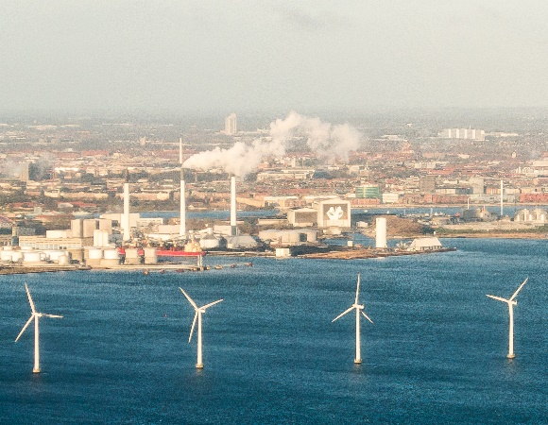
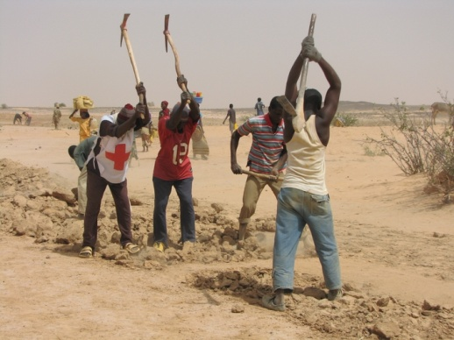
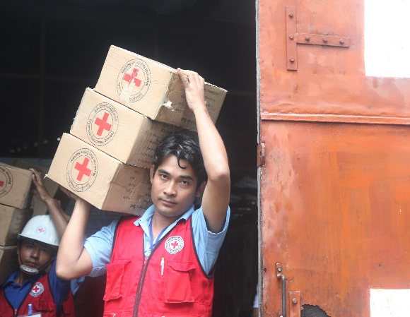
Climate change - ‘mitigation’ and ‘adaptation’
Climate Change Mitigation:
tackling the causes of climate change
Climate Change Adaptation:
preparing for managing the changes
Main focus for our
humanitarian work
We all must contribute to stop further warming
Photos: Climate Centre
Photos: IFRC
IFRC Strategy 2030:
“We will integrate climate risk management – including adaptation and mitigation – across all of our programmes, operations and advocacy, and adopt better environmental management in our approaches to addressing exposure and vulnerability. ”
Notes:
7
7
Climate change commitments are strongly prioritized in the International Federation’s Strategy 2030.
The Strategy 2030 focuses on integrating climate risk management across all of our programmes, operations and advocacy and emphasises the importance of contributing to climate change adaptation as well as mitigation.
As an organization we focus mostly on the humanitarian aspects of climate change and strive to reduce vulnerability – i.e. we have a stronger immediate mandate to focus on ‘adaptation’.
As noticed on previous slide, our own 'greening' of activities is an important responsibility – and we all – including National Societies – have a responsibility to make every effort to minimize the greenhouse gas emissions from our activities. And we do recognize the necessity of mitigation efforts to reduce humanitarian suffering, and align ourselves with the statements made in the latest IPCC reports.
Sometimes the two agendas (mitigation and adaptation) combine for win-win solutions. For example: a reforestation initiative to prevent landslides will result in new trees that absorb carbon dioxide; our main target remains to prevent the landslide from happening and protect the most vulnerable.
NOTE the different meanings of ‘mitigation’: among disaster risk reduction practitioners, ‘mitigation’ often refers to ‘disaster mitigation’ or measures to reduce the impact of disasters, but in the climate change context it means halting global warming by reducing greenhouse gasses in the atmosphere.

Slide 8
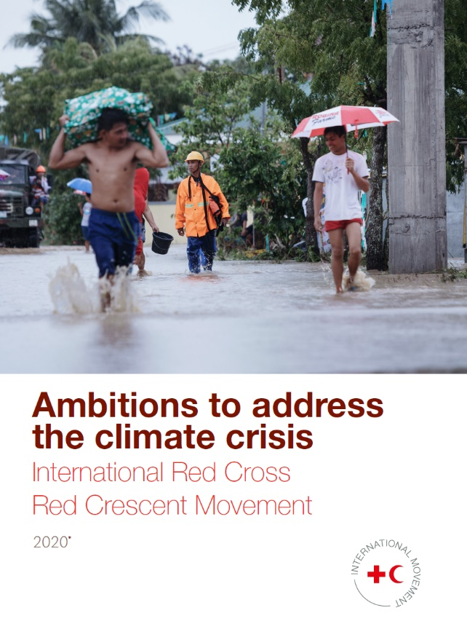
Movement ambitions on climate
Main focus
on 'adaptation'
adapt in the face of it
livelihoods, infrastructure and sustainable water management
C. Strengthen our volunteer base to reduce the impacts of the climate crisis
'mitigation'
Notes:
Likewise, at the IFRC General Assembly 2019 – back-to-back with the International Conference - the climate crisis was at the top of global humanitarian challenges as summarized in the
'Ambitions to address the climate crisis' document - summarized in the slide - and in the adoption of the IFRC Strategy 2030 where 'Climate and environmental crisis' was identified as the no. 1 'challenge'.
Those documents build on the IFRC Framework for Climate Action towards 2020 that was designed to support both IFRC and National Society planning processes and dialogue with partners and governments.

Slide 9
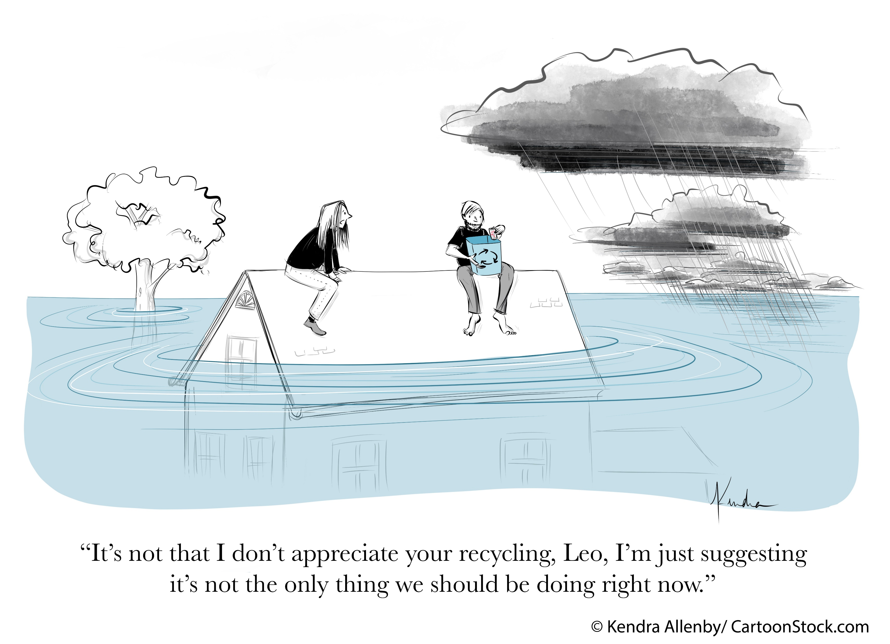

Slide 10
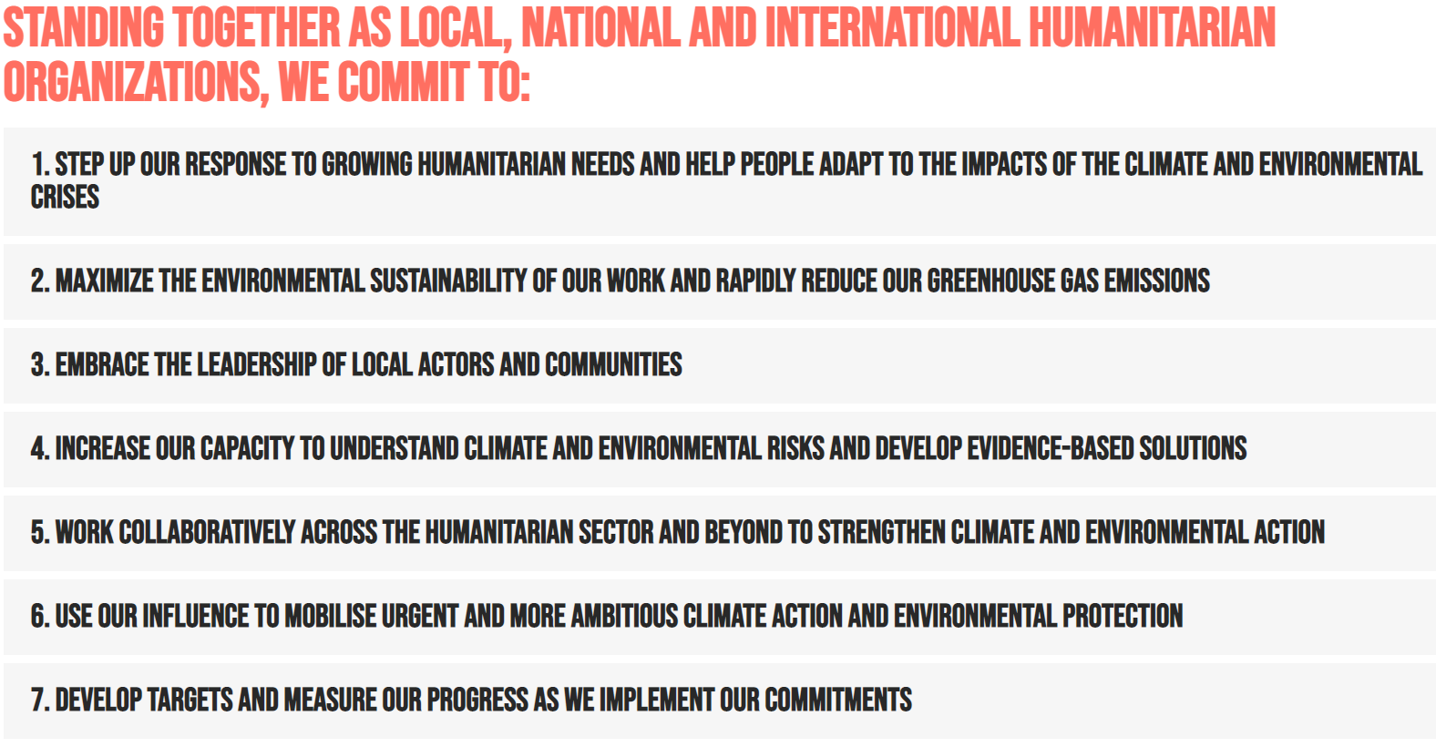
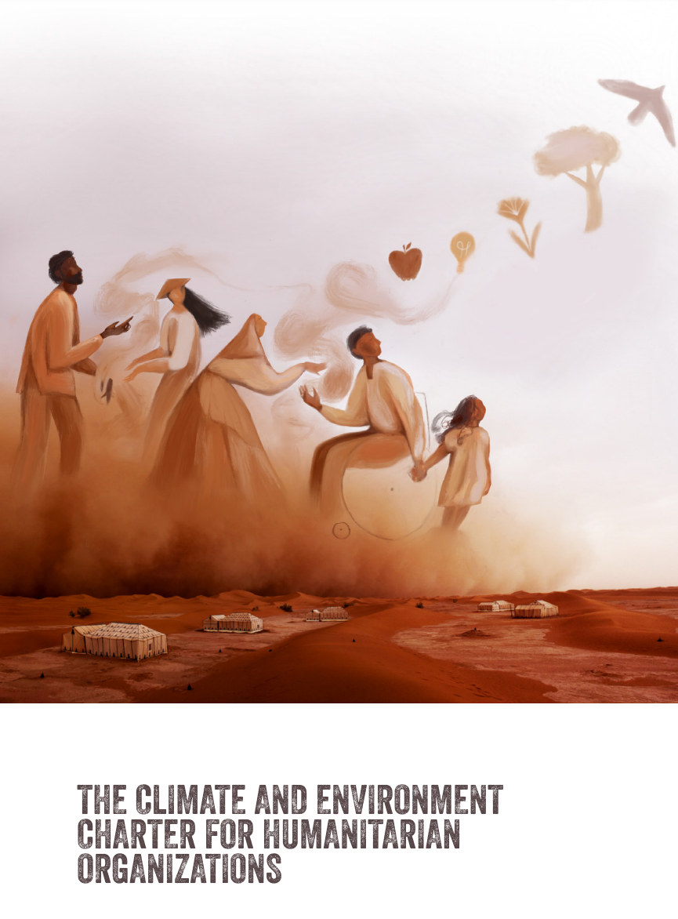
Climate & Environment Charter
Launched in May 2021
As of Jan 2022, 205 signatories from over 80 countries, including 64 National Societies
3 government supporters: Switzerland, US, Norway
Notes:
Link to charter:
https://www.climate-charter.org/
The development of the Charter was led by the ICRC and IFRC, and guided by an Advisory Committee of 19 people, including representatives of local, national and international NGOs, UN agencies and National Red Cross and Red Crescent Societies, as well as academics, researchers and experts in the humanitarian, development, climate and environmental fields.
The Charter has been developed by and for humanitarian organisations. Signatures will be accepted from not-for-profit organisations (whether they are Red Cross/Red Crescent, NGO, or inter-governmental) that provide humanitarian assistance and/or protection.

Slide 11
Climate & Environment Charter
targets by 2025:
Target 1
(Commitment 1)
Target 2
(Commitment 1)
Target 4
(Commitment 3)
Target 3
(Commitment 2)
Reach 250 million people with activities to address the rising climate risks
Climate and environmental risks are factored in all programmes and humanitarian operations
Reduce the greenhouse gas emissions from IFRC’s activities year-on-year, with progressive ambition
At least 100 National Societies have formulated explicit ambitions to address the rising climate and environmental risks in their operational plans, leveraging their auxiliary role and in collaboration with other partners

Slide 12
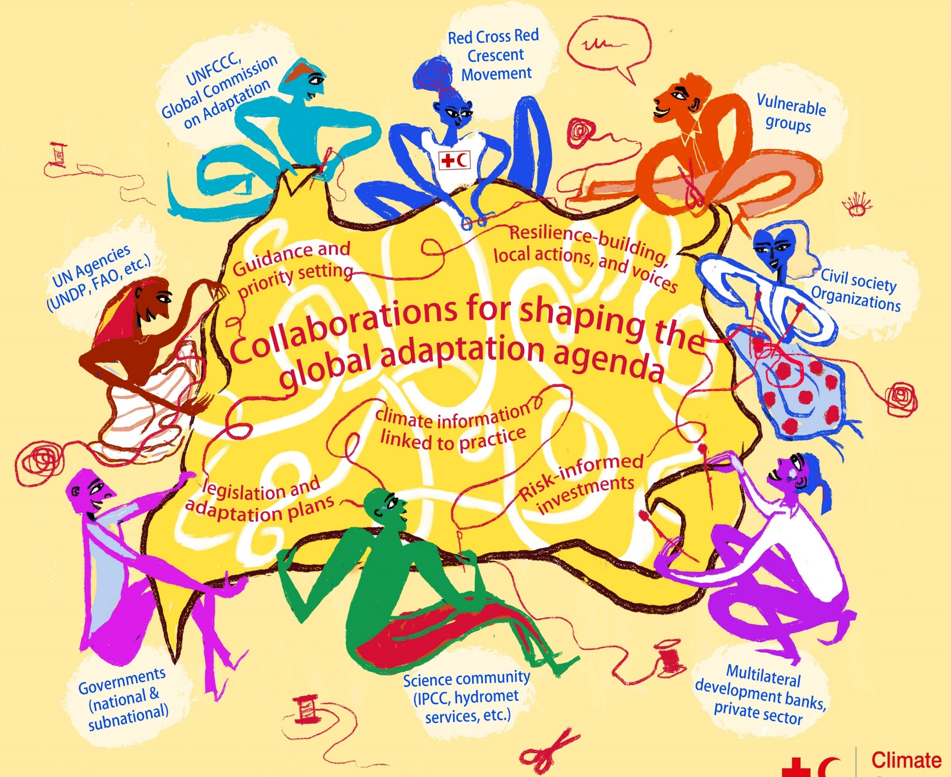
The Red Cross
Red Crescent
is not working on this in isolation
Notes:
Climate change is a cross cutting issue that affects many sectors and organisations, much is going on in the International arena to work out how best to reduce greenhouse gas emissions, who will pay for adapting to climate change and what can be done to reduce the impacts. At the national level it is also a similar story in that it involves many different sectors and organisations. At all levels, it is possible for Red Cross Red Crescent to engage on the topic of climate change adaptation with an important aim: firstly to ensure that climate change funding reaches the most vulnerable, and secondly for Red Cross Red Crescent Movement to show that it can assist in addressing the humanitarian implications of climate change. Therefore, it is important to keep briefed on current developments on climate change, and adaptation at all levels that Red Cross Red Crescent works at. Funding mechanisms, relevant international policies and latest science can all influence how we can address climate change within the Movement.
Key stakeholders are:
UNFCCC
IPCC
Global Commission on Adaptation
Multilateral Development Banks
(Sub) National Governments
Hydro Met agencies
Knowledge Centra and Academia
CSOs and vulnerable groups

Slide 13
Climate-smart programming
Climate-smart programmes and initiatives strengthen peoples’ awareness and incorporate climate and weather information in assessing and addressing climate risks and vulnerabilities. It enables ‘early warning early action’, and empowers people to anticipate, absorb and adapt to climate shocks and changing risks.
No stand-alone programming, but modifying what we already do.
Cross-cutting and cascading risks: climate change needs to be considered alongside other risks (health, environmental risks, ecosystem degradation, etc).
How does the wider landscape ("upstream”) affect risks in this community?
Notes:
First discuss the picture alone. The complexity of issues that this community faces ranges from poverty, pollution, floods, health risks, upstream water management and more. It is important that we take the work that we do as our starting point. Climate change aggrevates these existing risks. So we not need to start a seperate stand-alone programe, but look at how climate change will affect these existing vulnerabilities and then re-assess what types of partners, information, priorities and trade-off need to be collected and discussed to design proper climate-smart risk reduction interventions.
Climate-smart programming equates to ‘good programming’ and development, enabling people to anticipate, absorb and adapt to climate shocks and stresses by using climate information across timescales, considering landscapes and ecosystems as key areas of intervention – all in close collaboration with governments, specialists and the private sector.

Slide 14
Climate-smart programming
Climate smart | Programmes and operations have made use of available climate and weather information (both short-term weather and seasonal forecasts and long-term climate projections) in designing and/or adjusting activities to ensure that they contribute to reducing long-term risks and vulnerabilities, including likely unpreceden-ted extreme events.
Climate aware | Programmes and operations have used past and current climate and weather information in the design of activities (based on past extremes and forecasts) but not longer-term climate projections.
Notes:
In IFRC's 2019 survey of community programmes:
72% of all NS programmes tagged as climate-smart or climate aware: 49% Climate-aware and 23% climate-smart.
There are many risks that any given community may face and these risks may be different from one community to a next. They could be related to health, land tenure, agriculture or livelihoods.
In some cases, the concerns may be related to climate, but not always – this is important to keep in mind – and often environmental management is another key factor.

Slide 15
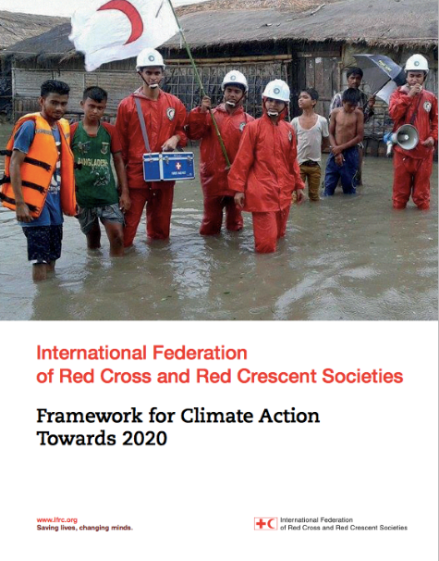
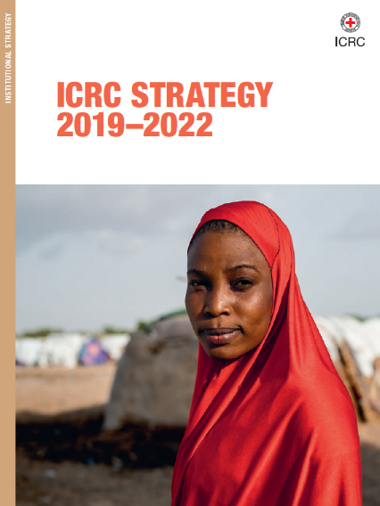
Who does what? – Movement entities
National Societies: facilitate awareness raising, assessments and climate-smart programming to address (changing) risks with communities. It can bring the experiences and needs of vulnerable people to the attention of policy makers at the sub- and national levels and support authorities to develop adaptation plans and legal frameworks (see further on next slides)
IFRC: Provide technical support to the National Societies in their endeavours and coordinates representation in regional and global level policy dialogues for climate risk management and climate finance to benefit vulnerable people
ICRC: Seeks to reinforce conflict-affected communities’ ability to absorb the combined consequences of conflict and
climate shocks
The Red Cross Red Crescent Climate Centre is a reference centre to the Movement and its partners, supporting capacity building and humanitarian diplomacy at all levels
Notes:
For the facilitators: please note this and the following slides are text heavy and most likely not needed to show or read out to an audience. It is important though that Red Cross actors understand different ambitions and roles within the Red Cross system. You can maybe only print these slides and ask the audience questions about who does what?
This slide reviews summarizes the headlines for main roles of the Movement - the specific points for National Societies are expanded in the rest of this presentation.

Slide 16
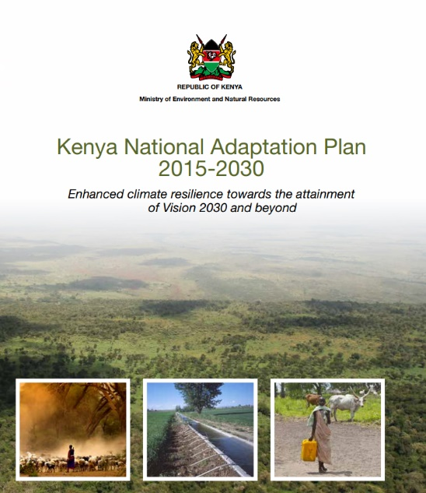
Who does what? – opportunities for National Societies to engage
National governments: national level adaptation planning (NAPs, NDCs etc.) and public investments; legal frameworks for risk reduction, climate finance proposals, and Hydro-Met services disseminating climate and weather forecasts, etc.
Line agencies/ministries – lead on investments and policies to address future risks; climate needs to be cross-cutting through initiatives of different Ministries.
Local governments: local-level planning/budgeting – implementing national and local priorities on adaptation, preferably in collaboration with communities, climate services, etc.
Private sector: relevant innovations, products, services, political influence, finance and capacities contributing to our resilience agenda. Collaboration is key to strengthen our adaptation and resilience agenda
Communities & households: identify resilience building and adaptation needs and implement locally relevant measures (e.g. farming and WASH practices and environmental management)
Civil society organisations and UN agencies: share the roles with the IFRC and National Societies and can be complementary partners in supporting climate-smart planning and policies, and channel adaptation funds to build resilience of vulnerable communities and households
Notes:
This slide reviews summarizes the headlines for main roles of different non-Movement stakeholders at national level.

Slide 17
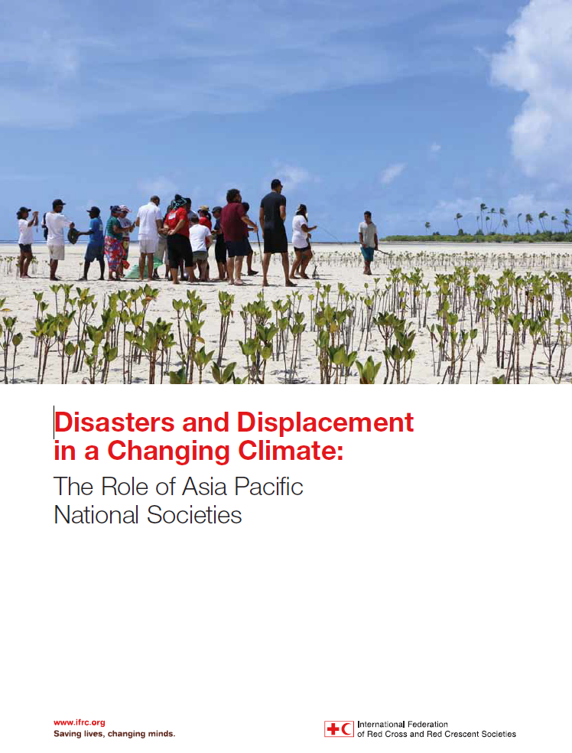
Red Cross Red Crescent Movement support: Climate and displacement
On average, more than 20 million people are newly displaced every year by sudden-onset hazards:
Impacts on displaced, vulnerable people as well as host communities.
Humanitarian needs include emergency shelter, health and psychosocial support, WASH, protection (violence, abuse etc.) and longer term support to recover and realize durable solutions.
Displacement often disproportionately affects already marginalised and ‘at risk’ groups
The challenges of disaster displacement, and the humanitarian impacts on those affects, are expected to be further amplified by the effects of climate change
But a complex set of factors, not climate alone, combine to induce displacement and, potentially, migration
Notes:
See full report here (and in 'Recommended Reading'): https://media.ifrc.org/ifrc/wp-content/uploads/sites/5/2018/12/2018-IFRC-Climate-Change-Disasters-Displacement-Report-LR.pdf

Slide 18
Red Cross Red Crescent Movement support: Climate and displacement
National Societies already play an important role in handling the temporary disaster displacement – and are already active in addressing migration and planned relocation in the context of disasters and climate change
"Human mobility" (migration, displacement and planned relocation) are increasingly addressed in national, regional and global laws, policies and strategies – and acknowledged as a long-term 'adaptation strategy'
National Societies/IFRC:
have important in humanitarian diplomacy towards the national, regional and global processes and dialogues
may consider how human mobility may put new demands on regular Movement engagement and planning
disaster management
Health
Shelter
water/sanitation/hygiene WASH), and
restoring family links (RFL)

Slide 19
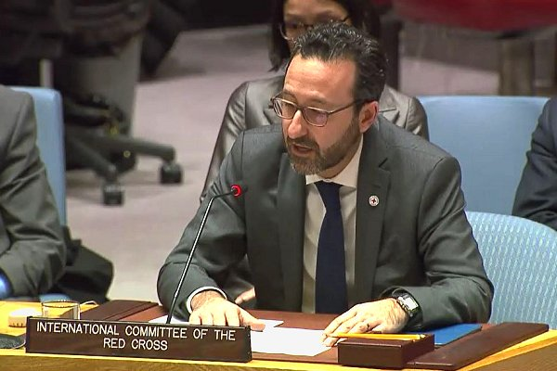
Red Cross Red Crescent Movement support: Climate and conflict
Short-term humanitarian problems caused by conflict and violence are made worse by longer-term trends like climate change, population growth, urbanization and uneven economic development.
ICRC:
supports communities to adapt and transform their capacities and resources to better manage future stresses caused by the combined effects of conflict and climate change
adapts its programming to systematically prevent degradation of the environment on which populations affected rely for their livelihood and well-being
enhances its own environmental responsibilities and policies to reduce its overall environmental footprint
Climate change is increasingly seen as a security issue: ICRC reminds the UN Security Council (2019) that “climate change deepens vulnerabilities for communities affected by war"
Notes:
To bolster the sustainability of its humanitarian response, the ICRC seeks to reinforce conflict affected communities’ ability to absorb the combined consequences of conflict and climate
shocks, and will:
–– support communities to adapt and transform their capacities and resources to better manage
future stresses caused by the combined effects of conflict and climate change
–– adapt its programming to systematically prevent degradation of the environment on which
populations affected rely for their livelihood and well-being
–– enhance its own environmental responsibilities and policies by improving its energy
efficiency, reducing its dependence on fossil fuels, reducing and ensuring proper treatment
of hazardous waste in the field and demanding higher quality and sounder environmental
practices of its suppliers.
See ICRC Strategy 2019-2022 (several languages) here: https://www.icrc.org/en/publication/4354-icrc-strategy-2019-2022
See full story on ICRC's address to the UN Security Council 2019 here: https://www.climatecentre.org/news/1098/first-ever-icrc-contribution-to-security-council-debate-on-climate

Slide 20
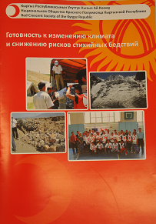
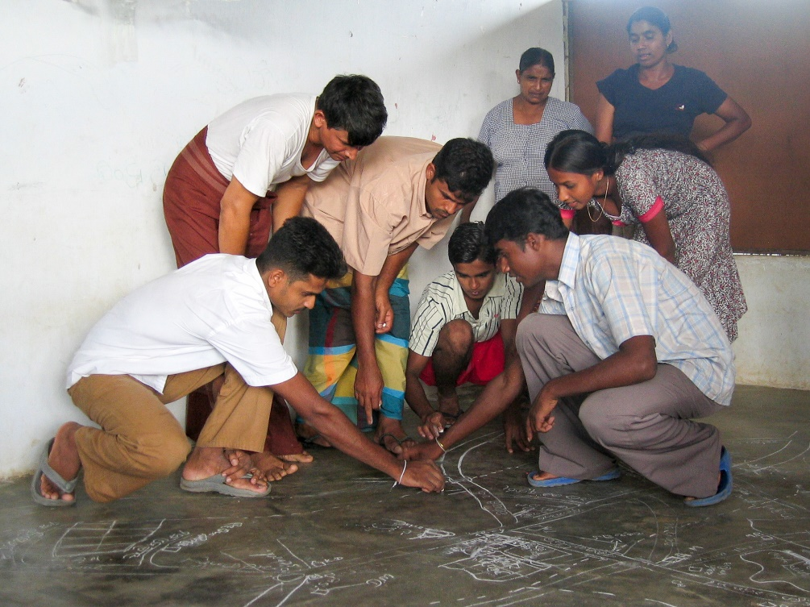
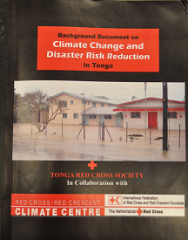
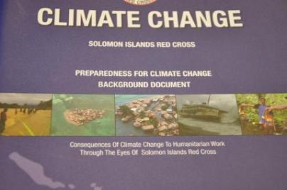
Key areas for the Red Cross Red Crescent Movement (as defined in the IFRC Framework for Climate Action towards 2020)
1. Increase our understanding:
This includes assessing the potential impacts of climate change and the implications for National Society mandate and programmes
Photo: Danish Red Cross
National Society climate risk assessments
Community assessments
Photo: Danish Red Cross
Notes:
In order to tackle rising risks, we must understand them. The Framework for Climate Action envisages that National Societies, IFRC regional delegations and the secretariat are well equipped to use climate change related knowledge in their work, and are conducting awareness raising activities together with partners. The best place for a National Society to start is to learn how climate risks are changing and affecting their work, and then develop ways to share that knowledge with communities to enable them to be better prepared.
I Climate risk assessment: assessing priorities, and planning follow-up. National Societies should start taking account of the rising climate risks in strategies and programme design, prioritization of activities and allocation of resources. The first step is to designate a focal point, and make a preliminary assessment of the potential impacts of climate change and the implications for their mandate and programmes. This can be done by the National Society or even jointly with a number of ‘new’ partners in your country. The assessment could take place within existing planning such as strategic planning and disaster management planning. Taking climate change risks into account during the Community Assessments (such as VCA and CBHFA) is also a relevant means of planning for vulnerability reduction in a changing climate.
20

Slide 21
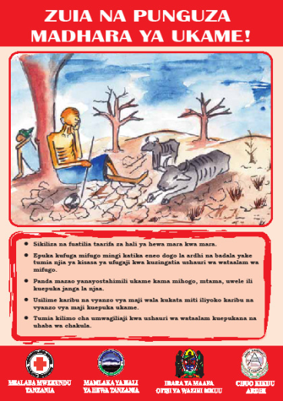
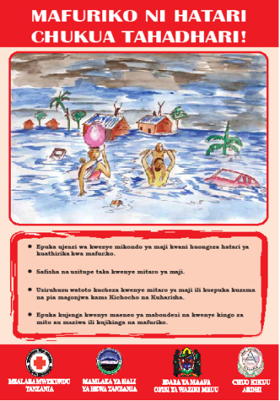
Four key areas for the Red Cross Red Crescent Movement
1. Build Knowledge and awareness: help people and institutions learn about climate change and its humanitarian consequences
Tanzania Red Cross leaflets
India Red Cross heat wave flash mobs
Notes:
III Raising awareness
One important role of the Red Cross Red Crescent is to help people and institutions learn about climate change and its humanitarian consequences, and most importantly solutions to address it, both through community-based activities and public-awareness campaigns. Up to 60 National Societies have prepared materials for awareness campaigns. For a more extensive overview catalogue: please have a look at the communication module in this climate training KIT, under the section ‘experience of other National Societies’.

Slide 22
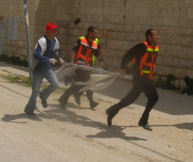
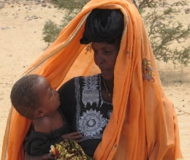
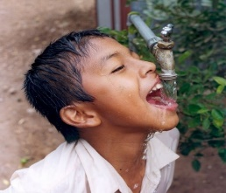
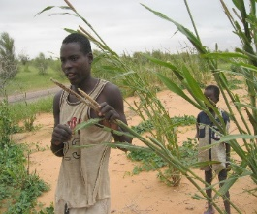
Key areas for the Red Cross Red Crescent Movement
2. Adaptation and climate-smart practices: integrate climate change in ongoing activities
Disaster management/ DRR, Resilience
Health & Care
Water, Sanitation and Hygiene
Climate (change) risks
Food Security, Social Protection
etc.
Notes:
II Addressing the consequences: Most areas of our work can be strengthened through making it ‘climate-smart’, our ambition is for National Society and IFRC interventions in different sectors to be climate-risk informed and implemented with an understanding of different scenarios that may occur as a result of climate change.
Our core approach therefore is to integrate consideration of rising risks into the program areas that are most affected (rather than to develop stand-alone climate change activities, which is less effective);
The Framework for Climate Action sets out example activities of how to integrate climate change across sectors, including:
• Disaster Management
First and foremost, climate change will bring more and different disasters, affecting all aspects of disaster management, ranging from an increase in relief operations to a need for more and better disaster risk reduction (see the module Disaster Management).
• Community risk reduction
In particular, National Societies need to step up efforts to help communities address the rising risks, through community based risk reduction, using tools such as Vulnerability and Capacity Assessments. (see the community risk module)
• Health and Care
Changing disease patterns will require adjustments in programmes to address health risks and promote health and care at the community level (see the health and care module)
• Food Security
Climate change is a major threat to food security, particularly in Africa, and will need to be addressed in food-security programmes, both through enhanced relief and better prevention. Few National Societies have explicitly integrated climate change into their food-security programmes. Over time, the Climate Centre will be developing additional guidance in this area.
• Water and Sanitation (Watsan)
Many National Societies are addressing water and sanitation issues, which are closely coupled to our priorities to promote better health and care. It is clear that climate change will have a major impact on water in many countries, and these changes will need to be factored into the design of Watsan programmes and infrastructure.
Note that the "etc." at the end includes all the widely different activities and programming that the National Societies implement – most of them may somehow be influenced by changing weather and climate

Slide 23
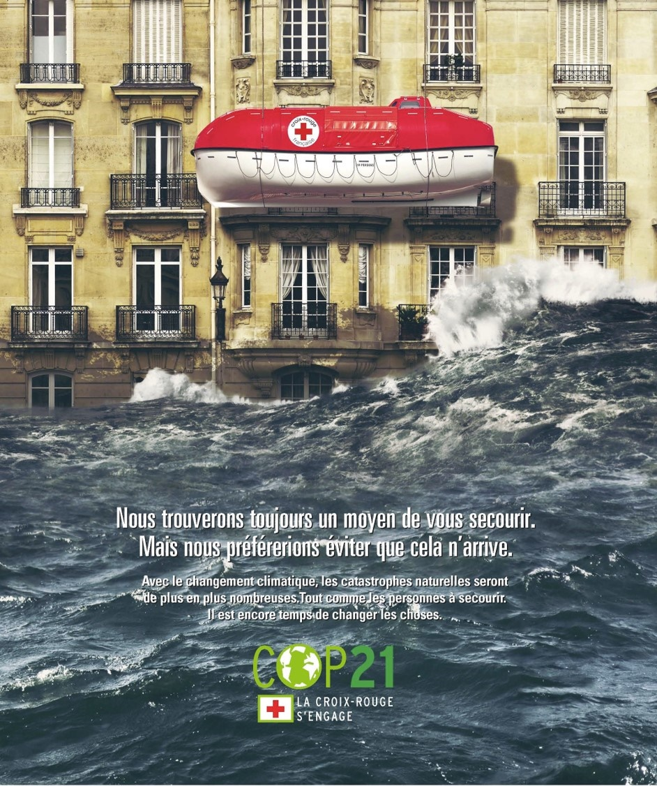
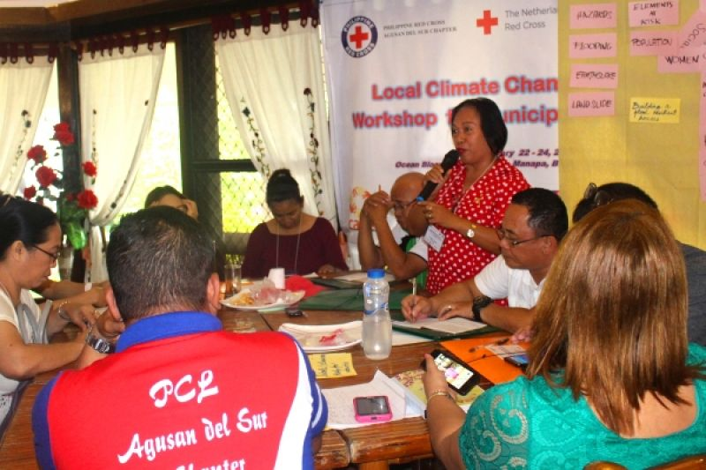
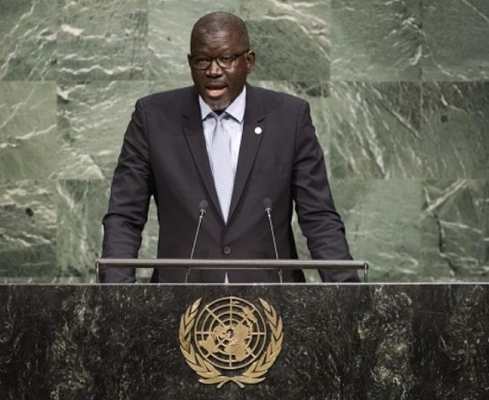
Four key areas for the
Red Cross Red Crescent Movement
3. Influence and partnership: at the local, national and international level, we can influence people, investments and policies
Philippines Red Cross engaging with local governments for shaping local development and adaptation plans
IFRC Secretary General, Elhadj As Sy, addressing the United Nations General Assembly
Poster: French Red Cross during the UNFCCC Paris Climate Change negotiations 2015
Photo: Danish Red Cross
Notes:
V Under influence and partnership, our ambition is for National Societies and the IFRC to successfully influence climate related laws, policies, plans and investments to prioritize the needs of the most vulnerable, and that we are increasingly recognized and consulted in this role. We also want to establish new partnerships with organizations and networks that strengthen are work and visibility in addressing climate change.
Policy dialogue – advocacy or humanitarian diplomacy – is necessary as we believe many international commitments made by governments are not yet implemented nationally or locally, or in a way that builds the resilience of the most vulnerable people.
Red Cross Red Crescent can engage in policy dialogues to ensure the most vulnerable people are addressed in adaptation planning in all countries. Our aims and key messages to pursue in the policy dialogues are set out within the IFRC Framework for Climate Action towards 2020.
As recognized auxiliaries to their governments, National Societies are a key actor supporting public authorities in addressing climate risks and often have seats in major decision-making fora at the national level. At the international level, the IFRC is in a strong position to contribute to the development of global and regional policies and frameworks, and to strengthen the position of the Movement with multilateral organisations and financial institutions. Together we can help shape decisions, policies and investments to ensure that the most vulnerable people are prioritized.
In Module 3, you can find many more ideas on which key messages and approaches are needed to in our national level policy dialogues.

Slide 24
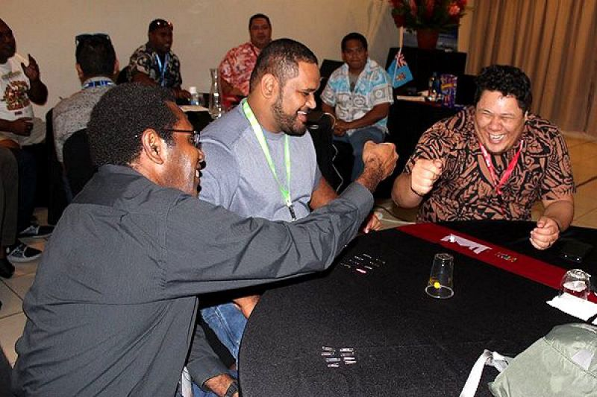
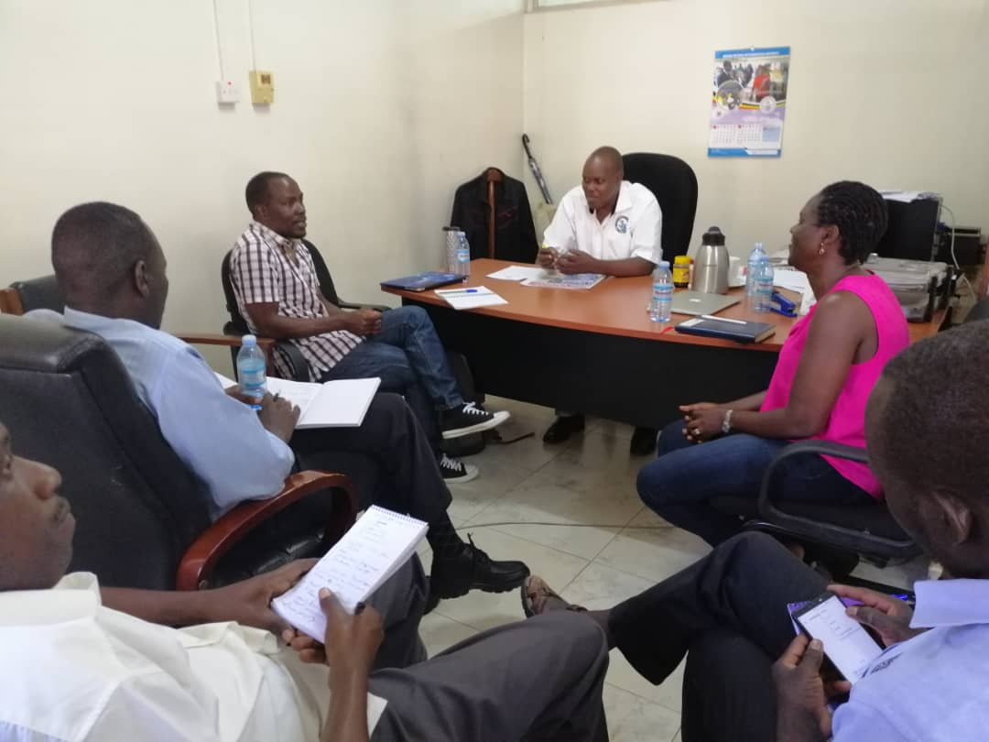
Four key areas for the Red Cross Red Crescent Movement
B. Influence and partnership: addressing climate change requires partnerships with for example: meteorological office, government agencies and NGOs etc.
Games training for technical officers at 4th Pacific Islands Outlook Forum (PICOF), Fiji, 2018
Red Cross meeting with Uganda Meteorological Services, 2019
Notes:
IV Establishing and enhancing partnerships
Addressing climate change cannot be done in isolation. It is key to work together with different sectors, to understand and address climate risks holistically.
Risk assessments require inputs from climate experts: for instance a very important partner is the national Hydro-Meteorological office. Risk reduction often requires partnerships with governments, NGOs, businesses, and others. National Societies’ local reach puts them in a strong position to help bridge the gaps between national and local stakeholders.
In this slide, you can make a reference to the beginning of the presentation and discuss with the audience who the NSs are already working with.

Slide 25
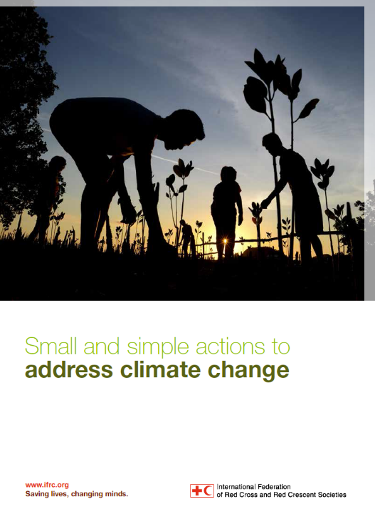
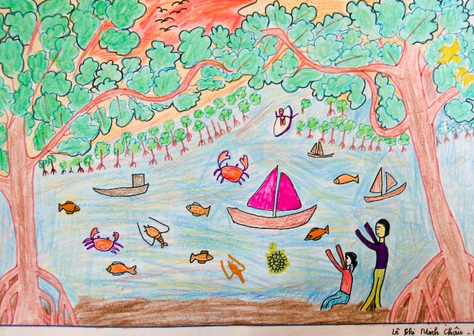
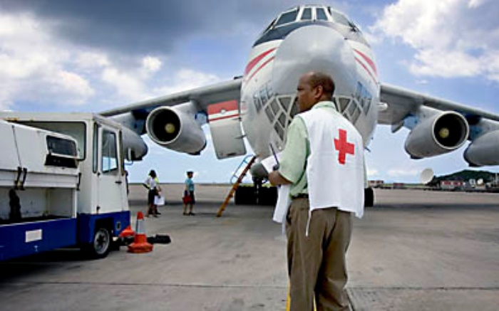
Four key areas for the Red Cross Red Crescent Movement
4. Mitigation and greening: reduce environmental and carbon footprint in all of the organization's activities; seek benefits between 'adaptation' and 'mitigation' in National Society programming
Reforestation has many benefits including:
enhanced resilience
growing trees absorb greenhouse gases and helps reduce global warming
Minimize National Society environmental footprint and GHG emissions in regular operations
Recycle and reduce energy usage in every possible way
For the remaining, unavoidable energy usage (GHG emission), consider "climate compensation" = funding other projects that supports renewable energy or reforestation etc.
Notes:
All Movement entities have – and must show – responsibility for minimizing their environmental footprint and greenhouse gas (GHG) emissions.
National Societies can help reduce GHG emissions within their programming, for instance by seeking synergies between the risk reduction, climate change adaptation or health efforts; an onbvious example is how tree-planing programmes can be a win-win situation:
Tree planting on a large scale helps both to mitigate climate change and adapt to it, and brings a range of health and economic benefits. Growing trees absorb carbon dioxide (CO2), one of the main greenhouse gases causing global warming; it is locked in while the trees remain alive.
Trees also prevent soil erosion and land degradation, lowering the risk of landslides and floods and potentially increasing crop yields. They give shade during heatwaves and provide non-timber products that can sustain livelihoods (fodder, green manure, feed for livestock). Mangrove forests shield coasts from wave damage in typhoons and storms: they can reduce a 1.5 metre wave to ripples and are seven times more cost-effective than dykes.
National Societies can help minimizing their environmental footprint and GHG emissions within their own activities – by engaging in and adhering to the IFRC's Green Response guidelines (still under dvelopment) – see websites here: https://media.ifrc.org/ifrc/green-response/
'Greening' of the National Soceity includes dedicated efforts in recyceling and saving energy – i.e. reducing flights (promote and web-meetings etc.), promoting public transportation, minimising heat/cooling needs (isolation etc.).
But for years to come it may still be unrealistic for an organisation to achieve 'carbon neutrality' – so for the GHG emission that cannot be avoided yet, there are many options for funding certified "climate compensation" projects. Some may only be reducing emisisons (like investing in solar panels), others – like reforestation or energy-efficient stoves etc. – may also have adaptation, ecosystem or health benefits in line with Movement priorities.
Some projects with certified "compensation projects" are listed here as examples (not as endorsement):
https://carbonfund.org/ https://www.myclimate.org/information/climate-protection-projects/
https://www.atmosfair.de/en/
https://www.goldstandard.org/get-involved/make-an-impact

Slide 26
Four key areas
4. Mitigation and Greening
Notes:
Tree planting can often have co-benefits of both adaptation and mitigation agendas. While for risk management, for instance to better manage water run off, you may need different trees than for mitigation purposes, it will be good to think about these trade-offs during the design of these interventions.

Slide 27
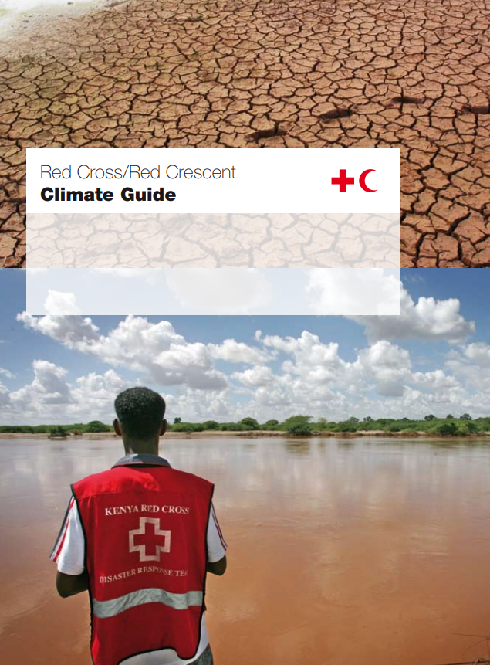
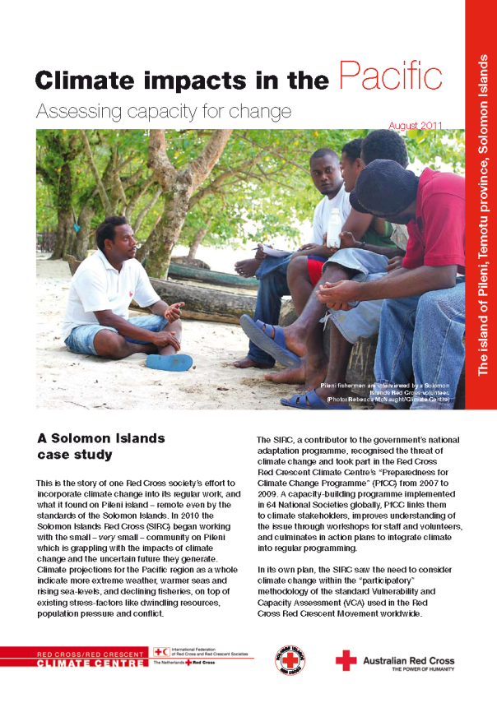
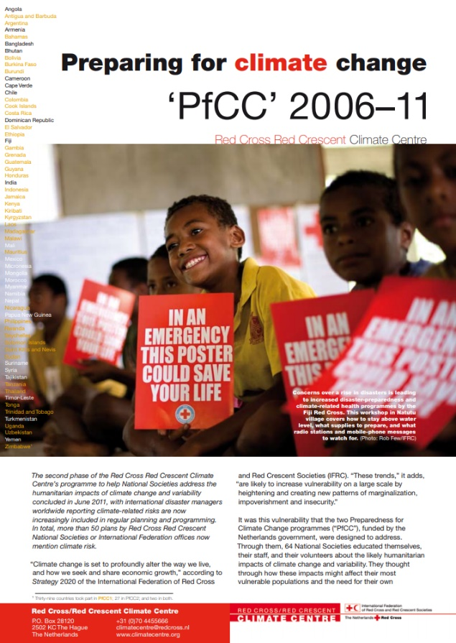
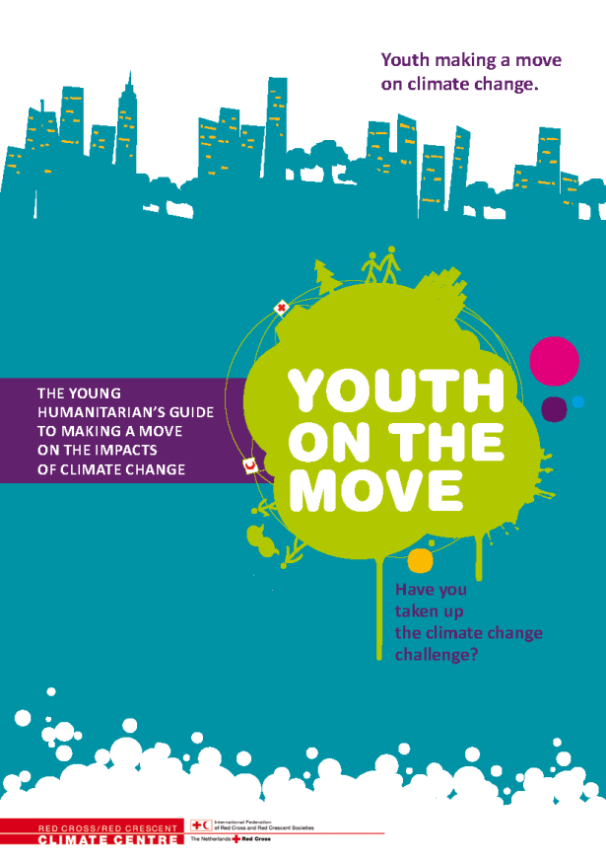
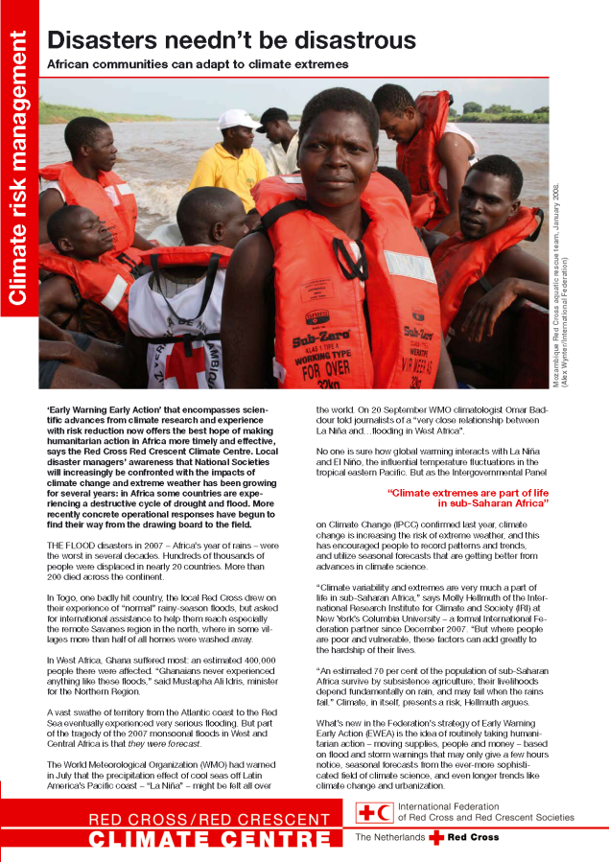
Please don’t forget: evaluate, document and share experiences and information
Notes:
VI Evaluating, documenting and sharing experiences and information
We are only just starting to address the rising risks, and there is much to learn. By sharing an experience you can promote the fact that your National Society has an approach that can actually help the most vulnerable people. It can motivate or inspire others!
27

Slide 28
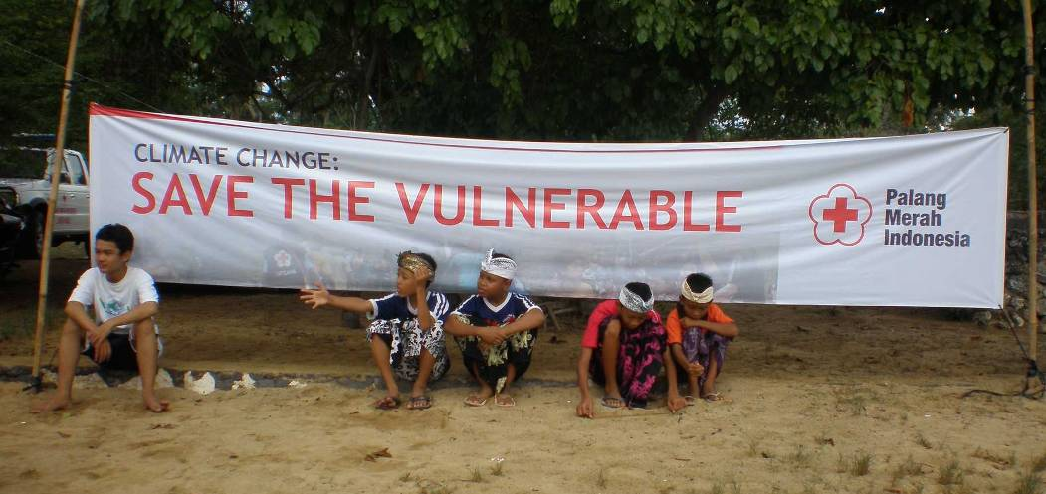
Photo: IFRC
Notes:
28
The rest of the Climate Training Kit modules will help with dealing with increasing climate risk in the regular programmes of the Red Cross Red Crescent Movement.

